Slide 1
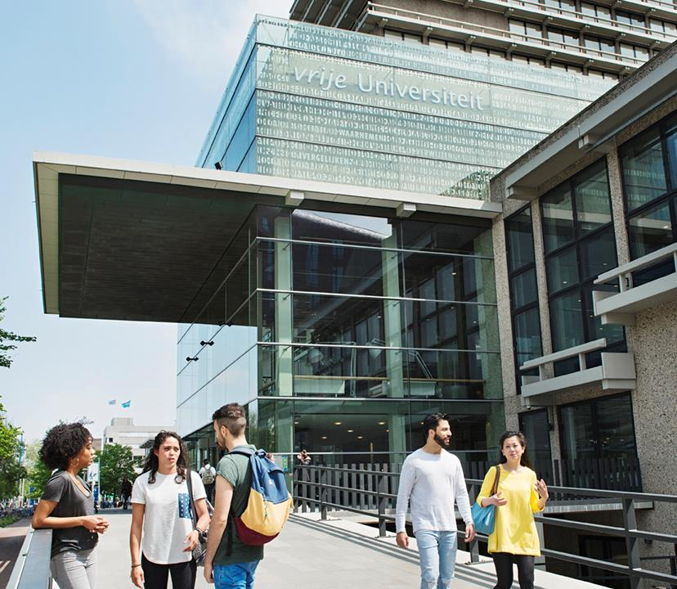

Writing a Data Management Plan
Workshop 1
FSW
Jolien Scholten (University Library) & Koen Leuveld (FSW)
15-6-2023
vu.nl/rds
libguides.vu.nl/rdm
rdm@vu.nl

Slide 2

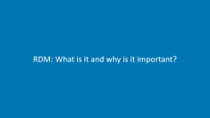
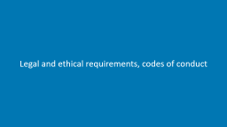



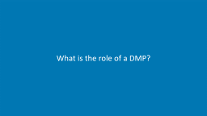

Slide 3
Introduction

Slide 4

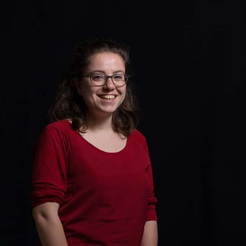
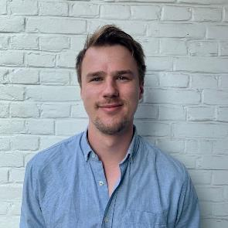
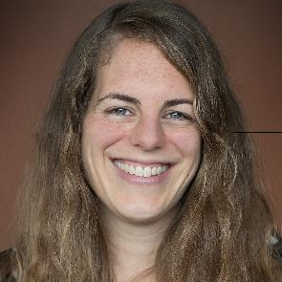
RDM Support Desk
Mark Bruyneel
Data specialist
Elisa Rodenburg
Data steward
Tycho Hofstra
Data steward
Jolien Scholten
RDM specialist

Slide 5
Learner’s objectives
Reflect on how FAIR principles and policies contribute to research integrity and transparency
Appraise value of careful RDM for a reproducible and transparent research practice
Identify requirements regarding RDM that apply to your research project
Create a DMP
Integrate requirements for RDM that are relevant for your research project in your DMP
Find the right support to solve future RDM-related issues

Slide 6
Roadmap
Workshop 1
RDM: What is it and why is it important?
General information
Data Description
Legal and ethical requirements, codes of conduct
Looking ahead: Preparation Workshop 2
Workshop 2
Storage and backup during the research process
Storing personal data
Data archiving and publishing
Documentation
Data management responsibilities and resources
Looking ahead: Assignments
Notes:
For version with GDPR

Slide 7
Roadmap
Workshop 1
RDM: What is it and why is it important?
General information
Data Description
Legal and ethical requirements, codes of conduct
Looking ahead: Assignment 1, preparation Workshop 2
Workshop 2
Storage and backup during the research process
Data archiving and publishing
Documentation
Data management responsibilities and resources
Looking ahead: Assignment 2, peer review, Assignment 3
Notes:
For version without GDPR

Slide 8
Assignment | Discuss your research | 5 minutes
Make pairs
Discuss your research with your breakout room fellow(s). Address the following issues:
Topic: My research is about…
Data: My research involves interview data/survey data/textual data/instrument data/…
Data management issues: I’m not sure how to deal with the storage, organisation, anonymisation, archiving, … of my data
If there are specific RDM issues you want to learn more about → add them to the Google Doc working document: http://tiny.cc/5a18vz

Slide 9
RDM: What is it and why is it important?

Slide 10
Research data
Research data
“[…] collected, observed or created for the purpose of analysis, to produce and validate original research results.” (Crossley 2014)
For example
Experiment results
Field notes
Observations captured in photo, film or audio
Scraped websites
Interviews
Survey answers
Data from Statistics Netherlands (CBS)
….and all data about the data

Slide 11
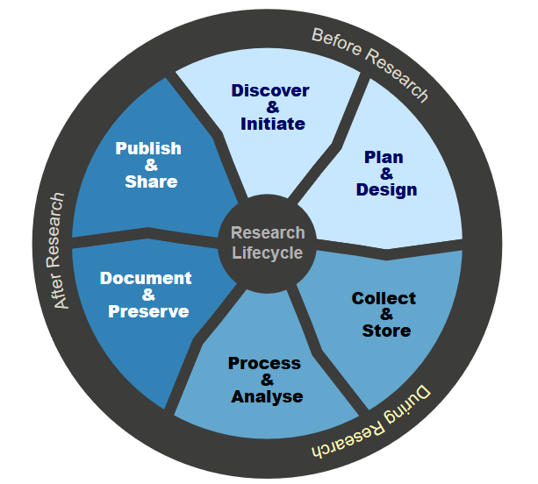
Research Data Management (RDM)
“Research data management concerns the organisation of data, from its entry to the research cycle through to the dissemination and archiving of valuable results.”
(Digital Curation Centre)

Slide 12

Why is RDM important?
RDM benefits

Slide 13
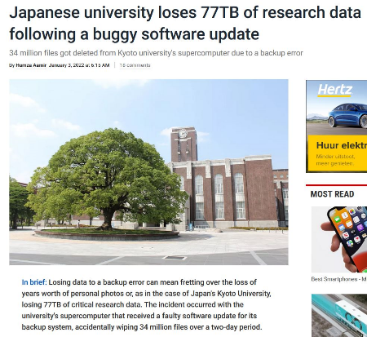
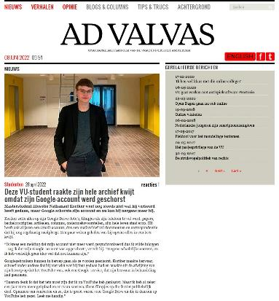
Prevent data loss
Japanese university loses 77TB of research data following a buggy software update
VU student loses all his data because he was banned from his Google account

Slide 14




Why is RDM important?
RDM benefits

Slide 15
What is the role of a DMP?

Slide 16
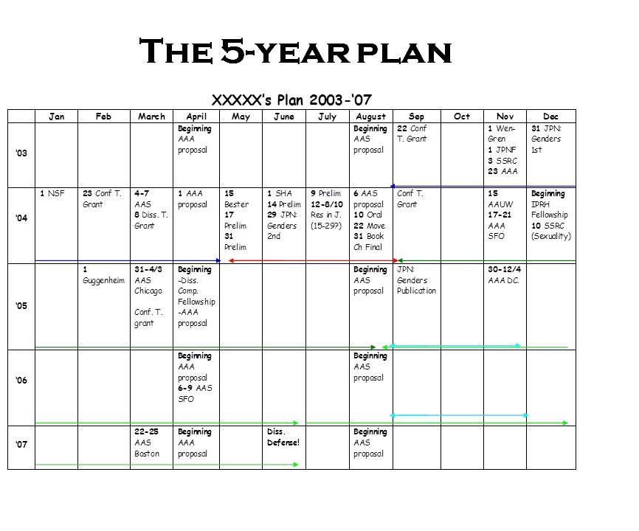
You need a plan
No matter what your goals are—a vision board can help keep you accountable
Don’t be afraid to make updates

Slide 17
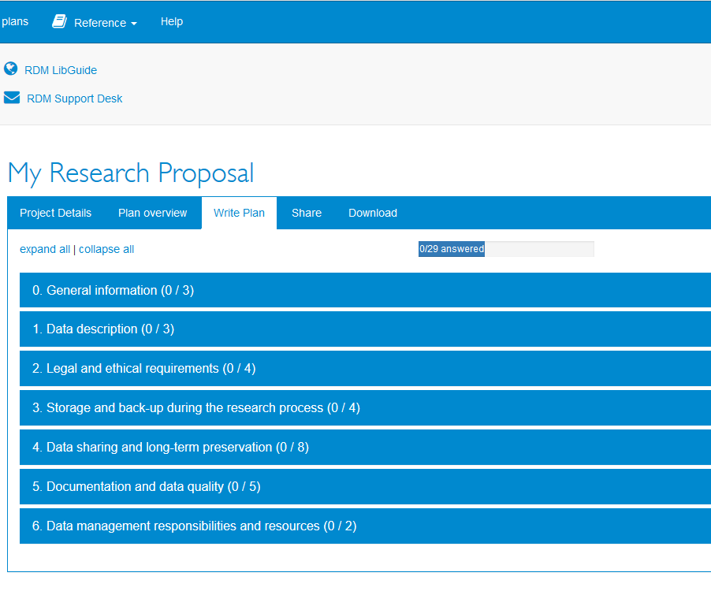

DMPonline – Structured plan writing
Think about RDM issues before your research project starts in a systematic way
https://dmponline.vu.nl
We strongly recommend to use the VU template.
Make sure to select the right one:
VU DMP template 2021 (NWO & ZonMW certified) v1.4

Slide 18
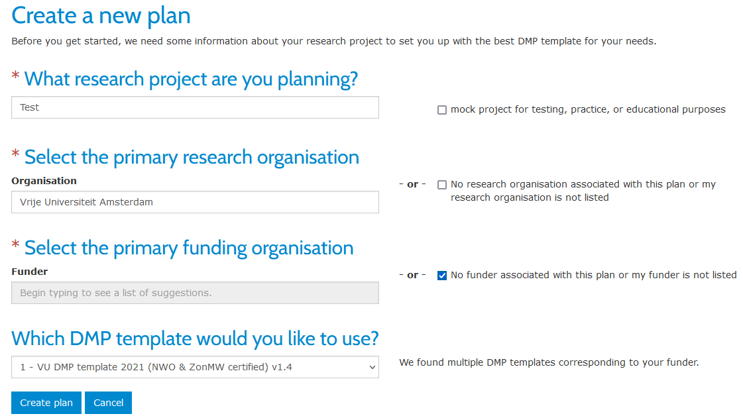
Choosing the right template
https://dmponline.vu.nl

Slide 19




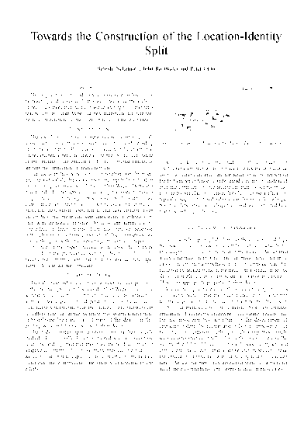

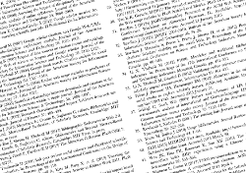

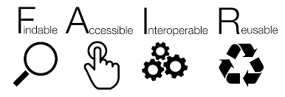
Open research output
data

Slide 20
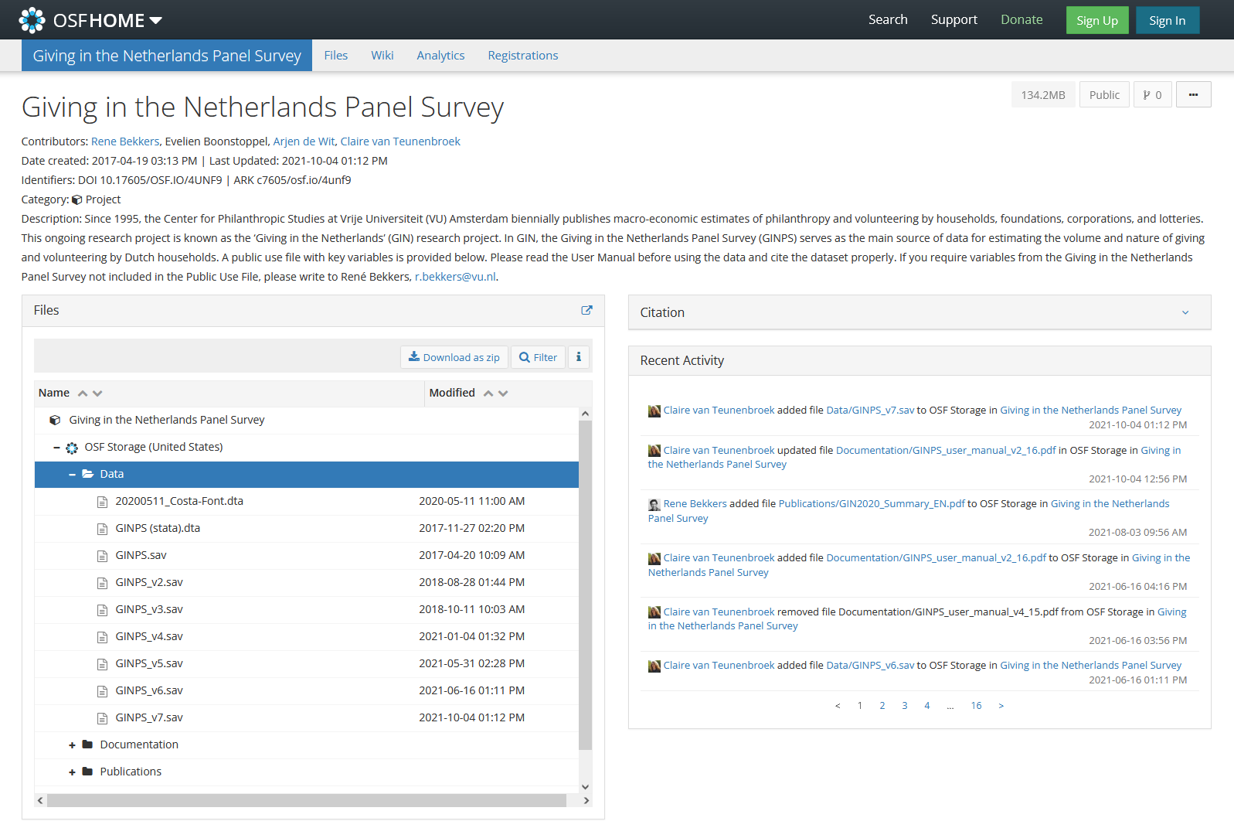
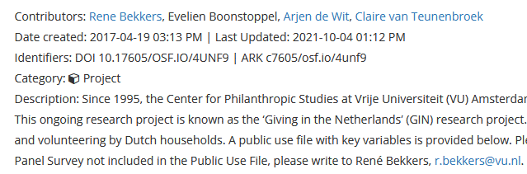
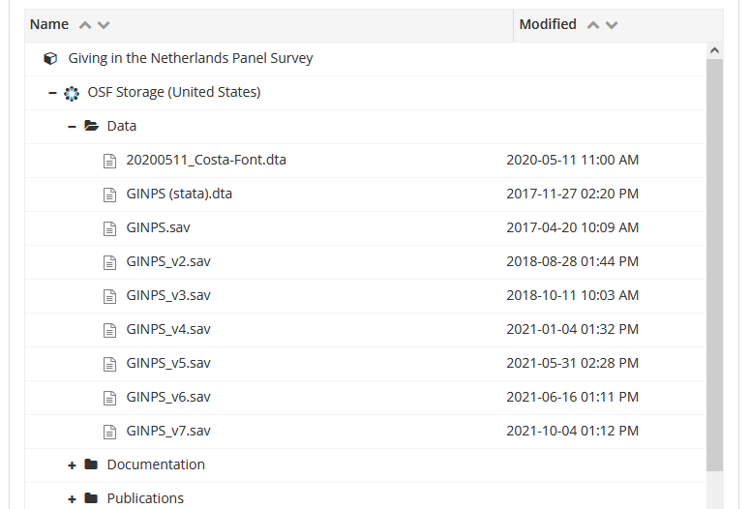
Linking data and publications: An example
Notes:
For FSW
http://journals.plos.org/plosbiology/article?id=10.1371/journal.pbio.2003489
An example of how data is linked to a publication
If you go to the article you get to a download page and from this page to all the data that underlies this publication

Slide 21
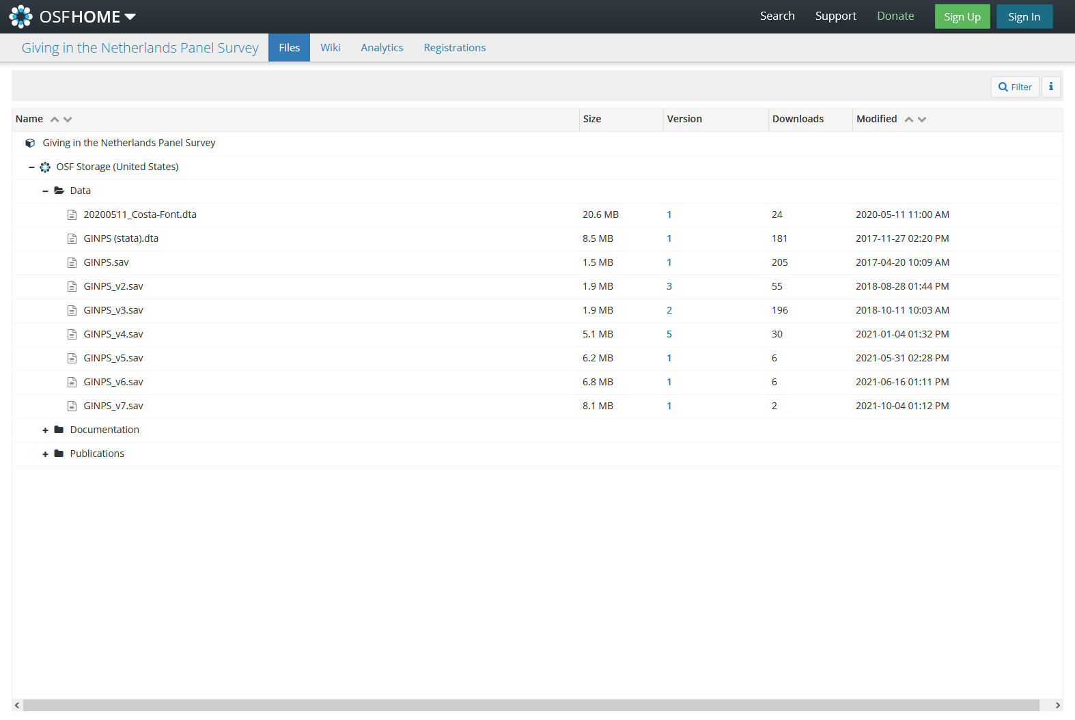
Linking data and publications: An example
Notes:
For FSW

Slide 22
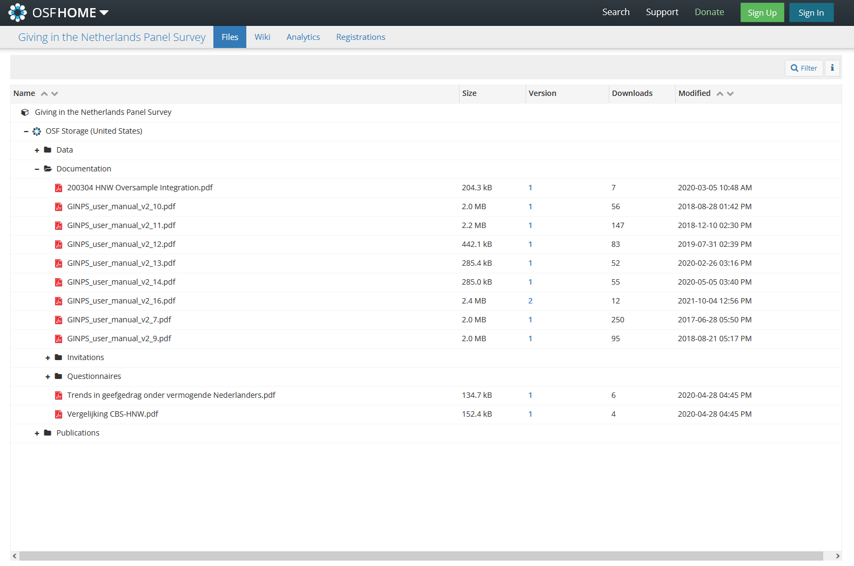
Linking data and publications: An example
Notes:
For FSW

Slide 23
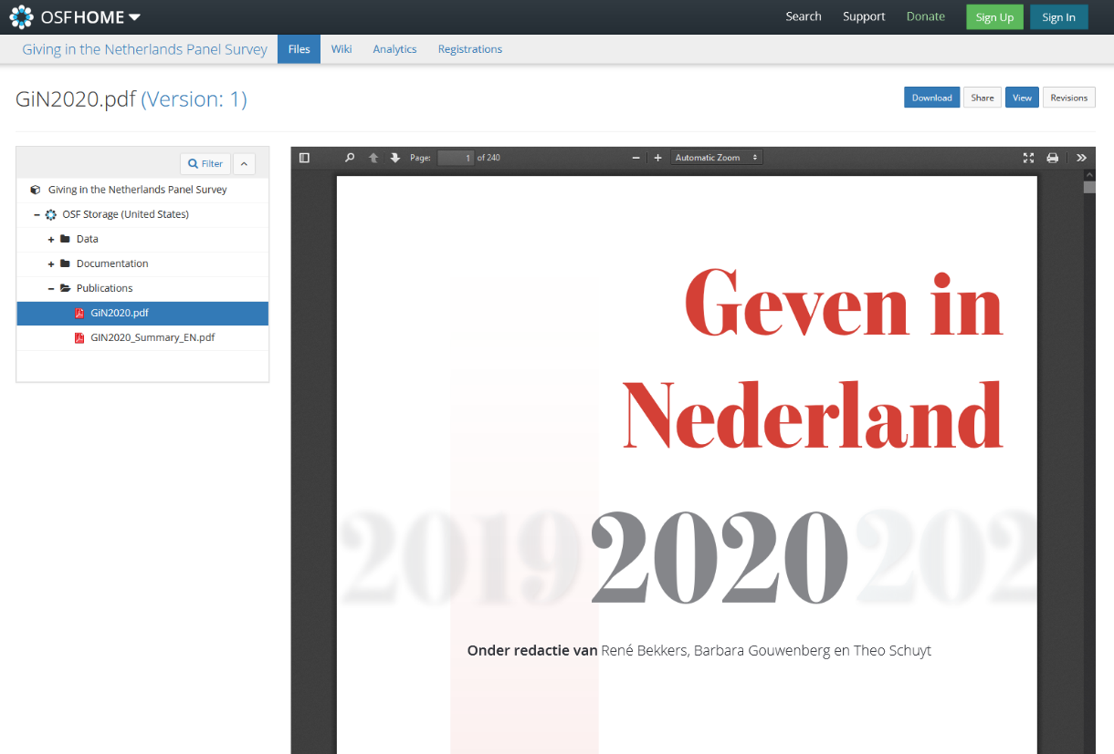
Linking data and publications: An example
Notes:
For FSW

Slide 24
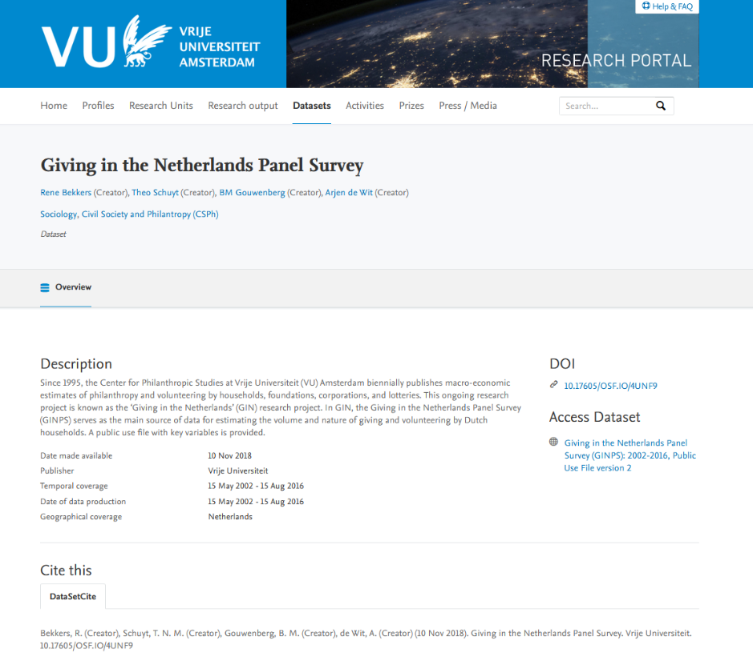
Linking data and publications: An example
Notes:
For FSW

Slide 25
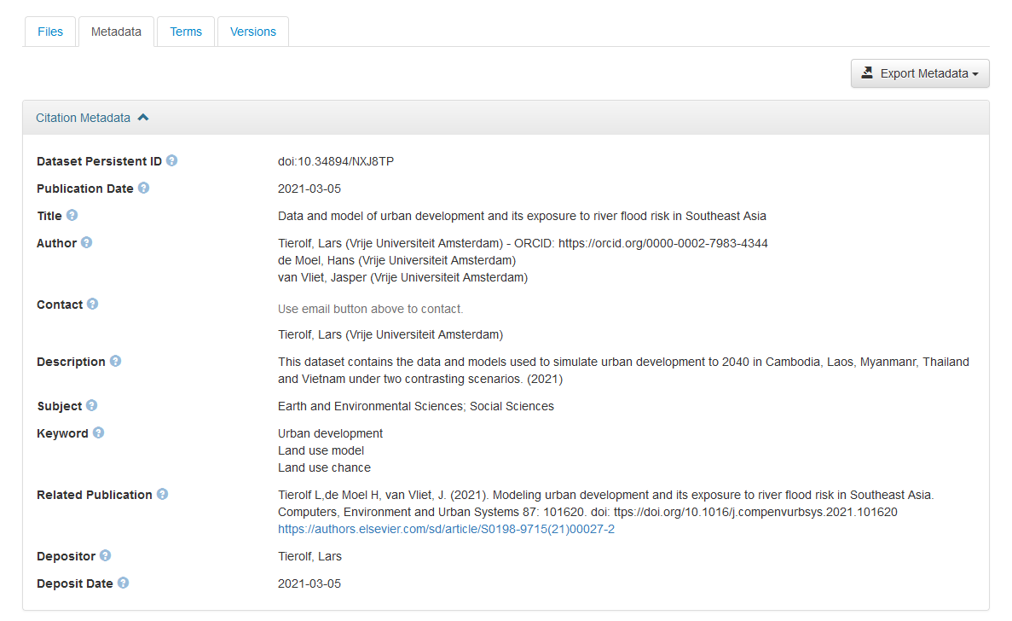
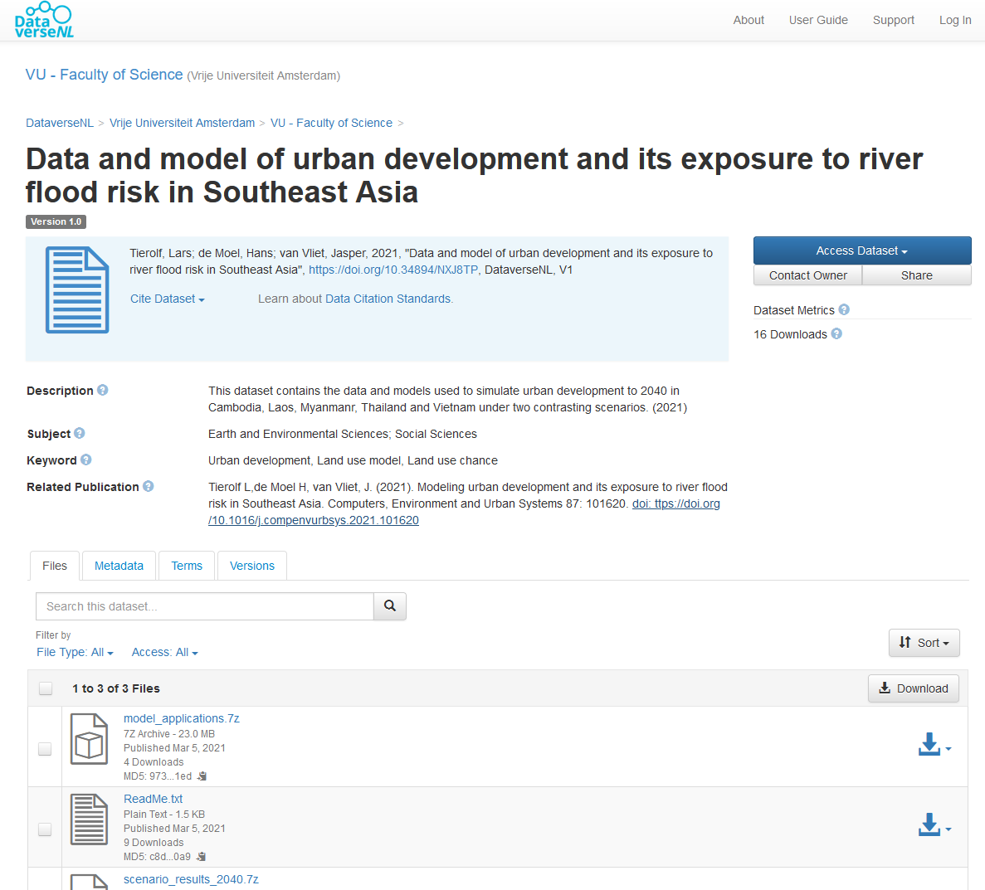
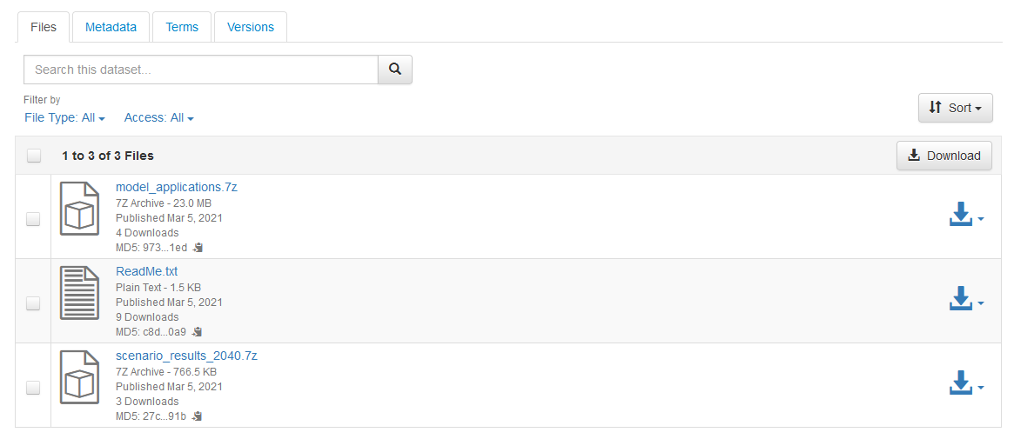
Linking data and publications: An example
Notes:
For FGB-Beta and/or courses in which no personal data are involved

Slide 26
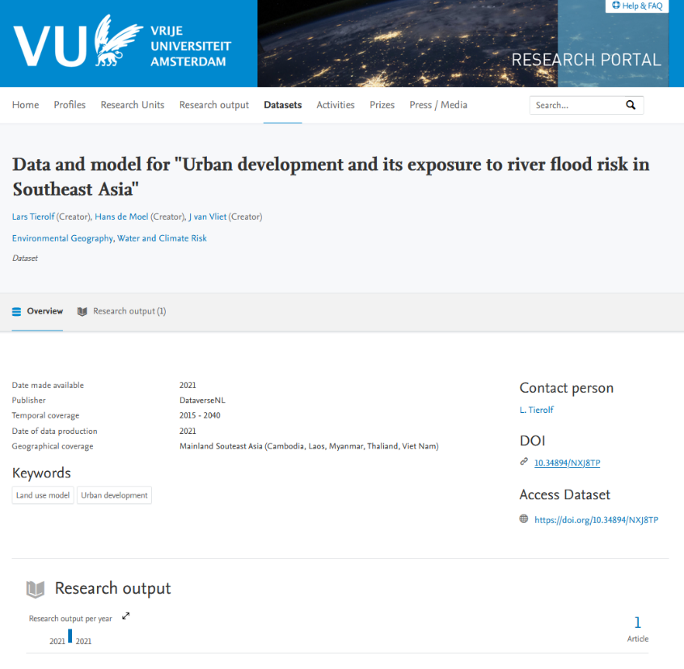
Linking data and publications: An example
Notes:
For FGB-Beta and/or courses in which no personal data are involved.

Slide 27
General information

Slide 28
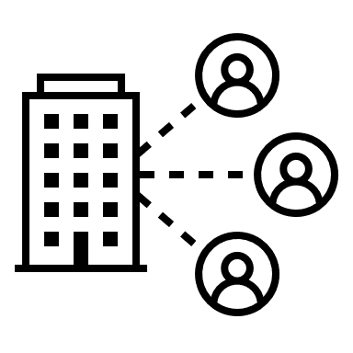
Information about your project
Most of this section is pretty straightforward
Two important aspects to pay attention to:
Include your ORCiD – register for an ORCiD if you don’t have one yet
Other people involved in the project
Supervisors, direct colleagues → important for responsibilities
Partner organisations (universities, medical centers, companies) → important for authorship, intellectual property, responsibilities
Establish your researcher identity with ORCiD

Slide 29
Data description

Slide 30

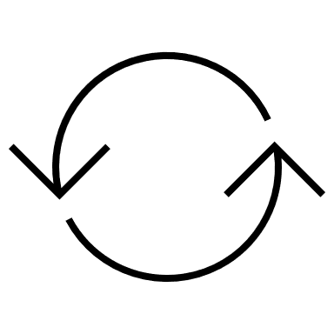

Origin of your data
Provide information about the data that you will be working with
Indicate whether you will work with personal data – the answer to this question defines which questions will be asked in the remainder of the DMP template
Reuse of existing data
Specify the source
Describe how you will get access to the data
Explain if there are any conditions for reuse
Collecting new data
Describe the methods of data collection
Describe data collection tool/measurement device/app
Describe standards and/or protocols used to collect and analyse your data, including how calibration of measurement device will be documented

Slide 31
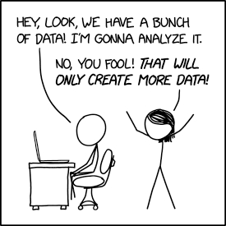
Describe your data assets
Conceptualise the parts of your dataset as entities to be managed and preserved
Possible way to organize your data assets:
Raw data
Processed data
Analysed data
Other (e.g. administrative, documentation)
Source: https://xkcd.com/2582

Slide 32
Data description | Example
Raw data
Data asset: interview recordings
Description: structured interviews recorded on audio
Format: .mp3
Processed data
Data asset: interview transcriptions
Description: automatically transcribed recordings
Format: .txt
Data asset: anonymised interview transcriptions
Description: transcriptions in which identifying information has been replaced or removed
Format: .txt
Analysed data
Data asset: scores on relevant variables
Description: spreadsheet with scores on variables that we’re studying
Format: .csv
Data asset: quotes
Description: quotes from interviews that are used to underpin the analysis
Format: .png
Other
Data asset: interview protocol
Description: description of how interviews are carried out
Format: .txt
Data asset: informed consent forms
Description: physical forms signed by participants
Format: physical
Data asset: code
Description: R syntaxes used to clean and analyse the scores on relevant variables, including documentation on what the syntaxes do
Format: .txt
Notes:
For version with GDPR

Slide 33
Data description | Example
Description | Type | Format | Size estimate | Sensitivity | Storage | Archiving
Interview recordings | Audio | mp3
Interview transcriptions | Text | txt
Anonymised interview transcriptions | Text | txt
Scores on relevant variables | Spreadsheet | csv
Quotes | Text | txt
Interview protocol | Text | txt
Informed consent forms | Text | Physical paper
Code | Syntaxes | txt
Notes:
For version with GDPR

Slide 34
Data description | Example
Raw data
Data asset: samples
Description: physical samples of soil/water/organism
Format: physical
Processed data
Data asset: chromatograms of samples
Description: retention time of the samples content
Format: .jpg
Data asset: spectra of samples
Description: nominal masses of the fractions of the compounds
Format: .jpg
Analysed data
Data asset: structures of compounds
Description: characterization of the structures in the compounds
Format: .jpg, .pdf
Other
Data asset: lab journal
Description: description of lab work, including conditions, reaction schemes
Format: physical
Notes:
For version without GDPR

Slide 35
Data description | Example
Description | Type | Format | Size estimate | Sensitivity | Storage | Archiving
Samples | Soil/water/ organism | physical
Chromatograms | Visualization of retention time of samples | jpg
Spectra | Visualization of nominal masses of the fractions of the compounds | jpg
Structures of compounds | Visual characterization of the structures in the compounds | jpg/pdf
Lab journal | Text and pictures | physical
Notes:
For version without GDPR

Slide 36
Recommended file formats
For the long term, some formats are more suitable than others
Ideally, file formats (see https://dans.knaw.nl/en/file-formats/)
Are frequently used
Have open specifications
Are independent of specific software, developers or vendors
Choosing a suitable format from the beginning (where possible), saves the trouble of converting files when you’re going to archive/publish your data
See DANS or UK Data Service for overviews

Slide 37
Assignment | Data description part 1 (5 minutes)
Think about the data that you will collect for your research project
Write them down and categorize them as you see fit

Slide 38
Assignment | Data description part 2 (10 minutes)
Discuss your data description with your neighbour
Revise where necessary
Try to add information about data type, file format, size

Slide 39
Legal and ethical requirements, codes of conduct

Slide 40
GDPR: Contents
What is personal data?​
The main rules​
Pseudonymization vs Anonymization​
Security​
International Transfers​
Roles

Slide 41
What are personal data?
Identified or identifiable natural, living persons​
​Text but also images and sounds​
​Objective or subjective​
​Direct or indirect identification​

Slide 42
Indirect identification
Notes:
For version with GDPR

Slide 43
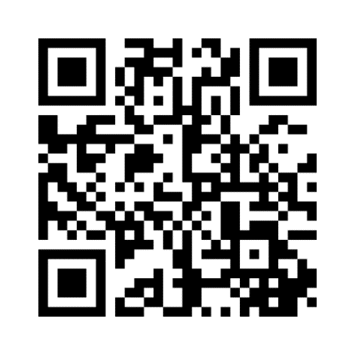
Let’s practice
Code: 5122 7414
Link: https://www.menti.com/als25cmcbey7

Slide 44
Personal data?
B. Janssen likes soccer
M. Haverkamp was a violin builder in Zierikzee until 1868
VUnetID abc200
Madonna is the most beautiful, says Michael Jackson
Table 3: residents of town A by age and drug use
Drug use Age | None | Softdrugs only | Harddrugs (possibly also softdrugs) | Total
< 15 years | 78 | 12 | 13 | 103
15 – 17 years | 2 | 367 | 12 | 381
18 – 21 years | - | 28 | 389 | 417
Total | 80 | 407 | 414 | 901
Notes:
For version with GDPR

Slide 45
What are the main rules?
Lawfulness, fairness and transparency
Purpose limitation
Data minimization
Accuracy
Storage limitation
Integrity and confidentiality > security

Slide 46
Legal ground scientific research: Consent or legitimate interest
Unambiguous consent of the data subject
Conditions
1. free
2. prior
3. informed
Children
For children up to 16 years: consent of parents/carers (Netherlands).
Necessary for representing a justified interest, unless this is outweighed by the privacy interests of the data subject
Balance between:
1. necessary, legitimate interest
2. privacy of data subjects

Slide 47
Types of personal data
Normal:
Everything that is not special
Special (art. 9 GDPR):
Race or ethnicity
Political beliefs
Religious or philosophical beliefs
Trade union membership
Health
Sexual behavior or orientation
Personal data relating to criminal law and personal data relating to unlawful or annoying conduct for which a prohibition has been imposed (art. 10 GDPR)
Genetic data
Biometric data
Note: indirect data as well!
Note: normal data can be sensitive!

Slide 48
You cannot process special categories unless:
General exception to the ban on processing: explicit consent of the data subject.
Exception of scientific and statistical research:
1. the research serves a public interest;
2. the processing is necessary for the research or statistics concerned;
3. asking for explicit consent proves to be impossible or to require a disproportionate effort; and
4. safeguards have been put in place for the processing such that the data subject’s privacy is not disproportionately compromised.

Slide 49
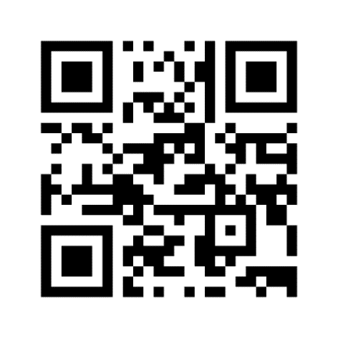
Let’s practice
Code: 3950 7129
Link: https://www.menti.com/66ieq3vijt

Slide 50
Pseudonymization vs. anonymization
Pseudonymization
No direct identifiers (names, addresses, etc).
Pseudonymized data is personal data: GDPR applies.
Useful to minimize the risk associated with data breaches.
Anonymization
Even indirect identification impossible (no Brown chickens).
Not personal data, GDPR does not apply.
Difficult!

Slide 51
Pseudonymization, anonymization in practice
Notes:
For version with GDPR

Slide 52
Security measures
Security measures should be appropriate. So the more sensitive your data, the more effort you are expected to do to prevent data loss or data breaches. In any case:
Consider pseudonymizing your data.
Only store (sensitive) (personal) data on secure environments.
Use SURFfilesender and/or Research Drive for sending sensitive files.
Make sure hard drives and USB drives are encrypted (Bitlocker / Filevault / Veracrypt / Cryptomator).
Make sure you use multi-factor authentication.
Make sure you have a unique pass phrase.
Make sure you are not hacked: https://laatjeniethackmaken.nl

Slide 53
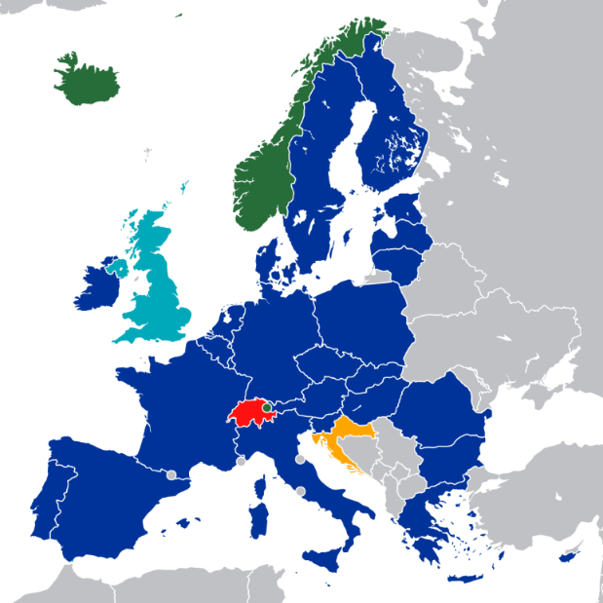
International transfers
Transfers are:
Disclosing personal data to a party outside the European Economic Area (EEA).
Provide access to personal data to a party outside the EEA.
Transfer of personal data outside the EEA is prohibited, unless:
Adequacy decision (art. 45 GDPR)
Appropriate safeguards (art. 46 GDPR)
Specific situations (art. 49 GDPR)
→ Contact privacy champion!
 | EU
 | European Free Trade Association and member EEA
 | EU member but EEA agreement applies
 | EFTA member but not EEA member
 | Former EU and EEA member
Map: Kolja21, Fry1989

Slide 54
Division of roles
(Data) Subjects
Living natural person whose personal data is being processed
Controller
Natural person or legal entity
Alone or together with others
Determines purpose and means
Broad legal responsibility
Processor
Natural person or legal entity
Processes on behalf of the controller
More narrow legal responsibility
Source: European Data Protection, Participant Guide - IAPP

Slide 55
Division of roles
Processor
Joint controllers
Independent controllers
Controller
Controller
Controller
Controller
Controller
Processor

Slide 56
Let’s practice
Code: 3950 7129
Link: https://www.menti.com/66ieq3vijt

Slide 57
GDPR: In summary
Are you using personal data?
What is your legal ground to process the data?
Informed consent
Legitimate interest
Contact your privacy champion if there are special concerns, for example:
You need agreements with processors or other controllers;
Transfers outside the EU;
Special or sensitive data;
Merging several large-scale data sets;
Having AI make decisions that affect data subjects; or
If you have any doubts.
Make sure the level of data protection suits the sensitivity of the data.

Slide 58
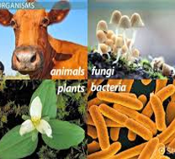
Research with genetic resources
Research where genetic resources are collected possibly fall under:
Nagoya Protocol for international transport of plants, animals, fungi, organisms based on agreements on Access and Benefit-Sharing (ABS) for protection and sustainable use of biodiversity
Contact nagoya@vu.nl
Regulation for genetically modified organisms
Contact Biological Security Officer: Marjanne Markerink-van Ittersum at nagoya@vu.nl

Slide 59
Wrap up

Slide 60
Follow up
Workshop 2: 22-6-2023, 13:00-15:15
Questions about the course?
→ rdm@vu.nl (please include FSW 2023-1 in subject or message 🙏)

Slide 61
Writing a Data Management Plan
Workshop 2
FSW
Jolien Scholten (University Library) & Koen Leuveld (FSW)
21-6-2022
I: Research data support
E: rdm@vu.nl

Slide 62

Today
Finalizing Workshop 1: Security measures
Short recap | Legal and ethical requirements
Storage and backup
Archiving and publishing
Research documentation
RDM responsibilities and resources

Slide 63
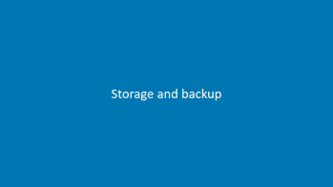


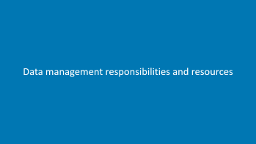
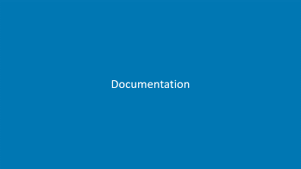


Slide 64
Recap from Workshop 1

Slide 65
Pseudonymization vs. anonymization
Pseudonymization
No direct identifiers (names, addresses, etc).
Pseudonymized data is personal data: GDPR applies.
Useful to minimize the risk associated with data breaches.
Anonymization
Even indirect identification impossible.
Not personal data, GDPR does not apply.
Difficult! It should not be possible to:
Single out a single person;
Link various records to an individual; or
Infer information about an individual.
For more information (in Dutch):
(WP216, Advies 5/2014 over anonimiseringstechnieken, WP29) - https://www.pdpjournals.com/docs/88197.pdf
De ‘achterkant’ van anonimiseren: https://pure.uva.nl/ws/files/1834030/107610_thesis.pdf

Slide 66
Pseudonymization, anonymization in practice
Notes:
For version with GDPR

Slide 67
Security measures
Security measures should be appropriate. So the more sensitive your data, the more effort you are expected to do to prevent data loss or data breaches. In any case:
Consider pseudonymizing your data.
Only store (sensitive) (personal) data on secure environments.
Use SURFfilesender and/or Research Drive for sending sensitive files.
Make sure hard drives and USB drives are encrypted (Bitlocker / Filevault / Veracrypt / Cryptomator).
Make sure you use multi-factor authentication.
Make sure you have a unique pass phrase.
Make sure you are not hacked: https://laatjeniethackmaken.nl

Slide 68
GDPR: In summary
Are you using personal data?
What is your legal ground to process the data?
Informed consent
Legitimate interest
Contact your Privacy Champion if there are special concerns, for example:
You need agreements with processors or other controllers;
Transfers outside the EU;
Special or sensitive data;
Merging several large-scale data sets;
Having AI make decisions that affect data subjects; or
If you have any doubts.
Make sure the level of data protection suits the sensitivity of the data.

Slide 69
Regulations and requirements
Which regulations and requirements are applicable to your research?

Slide 70
Storage and backup

Slide 71
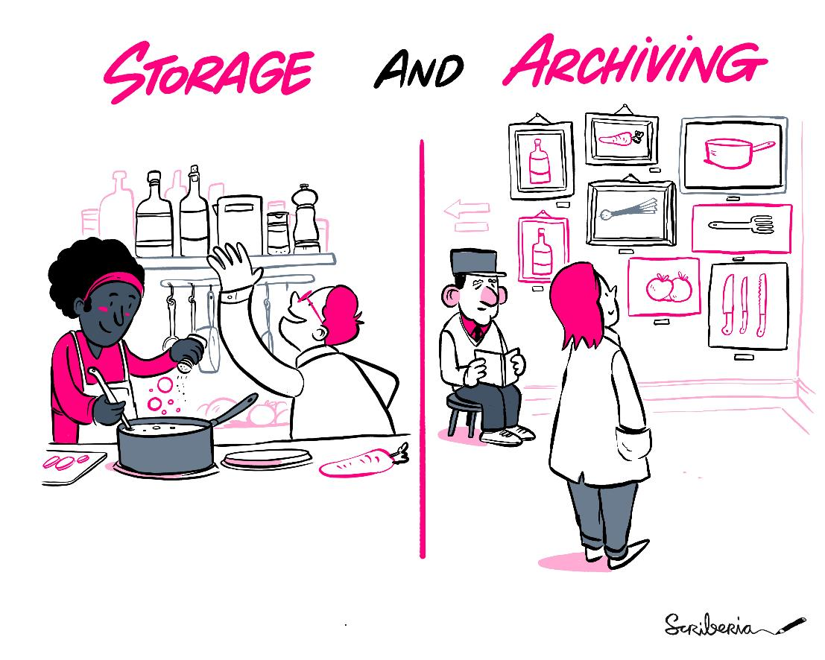
Storage vs archiving
This image was created by Scriberia for The Turing Way community and is used under a CC-BY 4.0 licence for reuse. Zenodo. DOI 10.5281/zenodo.3332807

Slide 72

Storage: What do you use?
Let’s check in Menti
What kinds of storage do you use in research projects?

Slide 73
Rules and regulations
NL Code of Conduct for Research Integrity
3.3.24 Manage the collected data carefully and store both the raw and processed versions for a period appropriate for the discipline and methodology at issue.
Source: Netherlands Code of Conduct for Research Integrity https://www.universiteitenvannederland.nl/files/documents/Netherlands%20Code%20of%20Conduct%20for%20Research%20Integrity%202018.pdf
VU RDM Policy
2. Researchers are responsible for ensuring that their research data are reliably, traceably and securely stored throughout the data life cycle and that they are able to report the storage location of their data to the department head […].
Source: VU RDM Policy https://libguides.vu.nl/ld.php?content_id=32045526

Slide 74
Rules and regulations
FSW RDM policy
3. Newly acquired digital data is usually stored and managed on the university’s G-drive or on Surfdrive [*]. If VU Amsterdam’s G-drive or Surfdrive is not sufficient, due to the type or size of the data, then the researcher will need to choose another data storage facility. Researchers are free to choose another data storage facility as long as it meets the legal requirements for research data storage and as long as the data is guaranteed to be stored safely and securely, in a well-structured manner, for the duration of the study.
Source: FSW RDM Policy https://libguides.vu.nl/ld.php?content_id=32045927
[*]: In the meantime, the IT department has stated that SURFdrive is not secure enough for storing personal data. Instead, Research Drive, Yoda or SciStor can be used.

Slide 75
Recap
Data must be:
Stored carefully
Stored safely
Managed securely
Stored reliably
…and it is all your responsibility during the research
Luckily we have storage solutions

Slide 76
Assignment
PhDs
Use the VU Storage Finder https://vu.nl/en/research/storagefinder to find the perfect solution for your research
MA students
Look into storage solutions available for students
OneDrive
SharePoint/Teams
Google Drive
Your own solutions
All
Fill the specifics of your storage solution into the working document http://tiny.cc/5a18vz
Capacity:
Backup procedures:
Accessibility (local, server, cloud, etc.):
Level of security:
Costs:
Possibility to assign and revoke access rights:
Link to more information:

Slide 77
Data archiving and publishing

Slide 78
During research vs after research
This image was created by Scriberia for The Turing Way community and is used under a CC-BY 4.0 licence for reuse. Zenodo. DOI 10.5281/zenodo.3332807

Slide 79
Rules and regulations
NL Code of Conduct for Research Integrity
3.3.25 Contribute, where appropriate, towards making data findable, accessible, interoperable and
reusable in accordance with the FAIR principles.
4.4.45 As far as possible, make research findings and research data public subsequent to completion of the research. If this is not possible, establish the valid reasons for this.
Source: Netherlands Code of Conduct for Research Integrity https://www.universiteitenvannederland.nl/files/documents/Netherlands%20Code%20of%20Conduct%20for%20Research%20Integrity%202018.pdf
VU RDM Policy
3. Researchers are responsible for archiving their research data for a minimum of ten years after research results are published, unless legal requirements, discipline-specific guidelines or contractual arrangements dictate otherwise.
4. Researchers are responsible for being able to share their research data for scientific use and verification, by making them accessible (A in FAIR) to others, preferably and where possible with a Persistent Identifier
Source: VU RDM Policy https://libguides.vu.nl/ld.php?content_id=32045526

Slide 80
Rules and regulations
FSW RDM Policy
4. For digital data, it is preferable to use the digital repositories offered by VU Amsterdam […]. If the VU repositories do not meet your requirements, then it is possible to archive the data elsewhere, as long as:
the location complies with the rules and legal requirements for archiving research data (determined by the research funder or others);
it can be guaranteed that the data can be stored safely and securely for a period of at least 10 years and agreements on data are drawn up and recorded (via licensing and processing agreements) with the organization behind the data repository;
This choice is accounted for in the data management plan […].
Besides the choice of an appropriate archiving location, it is essential to safeguard the quality of the archiving process. This means that:
Agreements on archiving (such as the retention period) are drawn up and agreed in the data management plan, including steps taken and motivations of decisions made, and shared with the whole research team;
a researcher has to get at least one fellow colleague’s opinion before he or she actually archives the data;
before the data is archived, the format has to be as close to the DANS preferential file formats as possible so the ten year retention period can be guaranteed.
Source: FSW RDM policy https://libguides.vu.nl/ld.php?content_id=32045927

Slide 81
Rules and regulations
FAIR data principles
Make data findable, accessible, interoperable and reusable in order to facilitate knowledge discovery and innovation
Sources:
The FAIR Guiding Principles for scientific data management and stewardship https://doi.org/10.1038/sdata.2016.18
Force11 FAIR Data Principles https://force11.org/info/the-fair-data-principles/

Slide 82
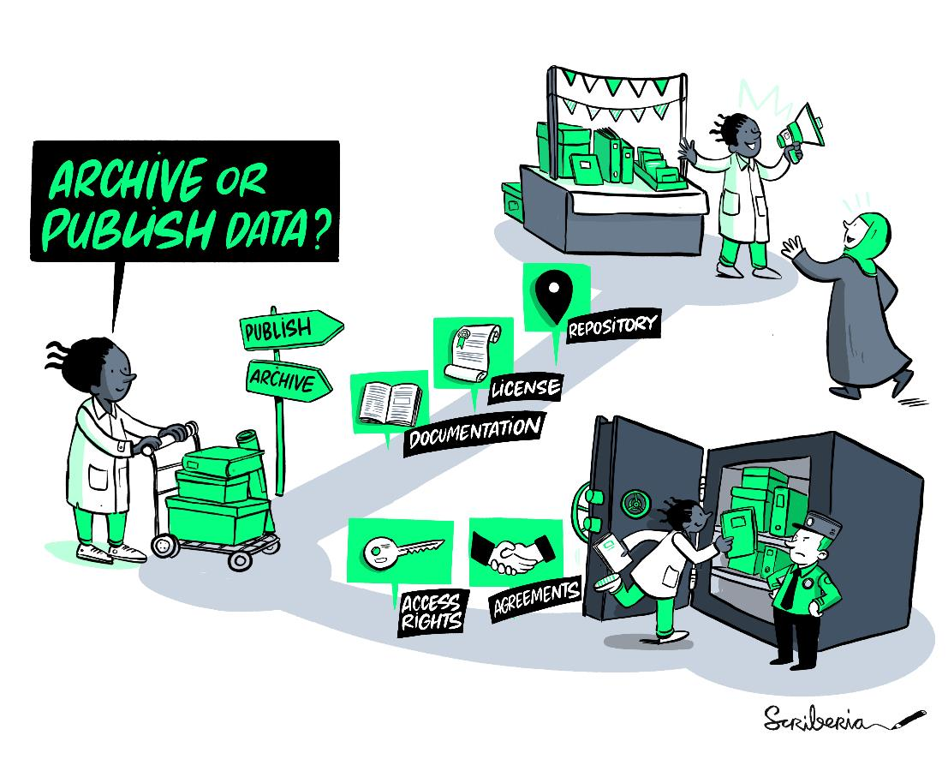
Archiving vs publishing
This image was created by Scriberia for The Turing Way community and is used under a CC-BY 4.0 licence for reuse. Zenodo. DOI 10.5281/zenodo.3332807

Slide 83
FAIR principles
Findable
Accessible
Interoperable
Reusable
Developed by researchers in the life sciences, but nowadays widely adopted by research institutions and funders for all disciplines
Goal: Facilitate knowledge discovery and innovation
How to do this in practice? Depends on your discipline.

Slide 84
FAIR principles
Findable
Data and Metadata is findable for both humans and machines
Accessible
Conditions for access are clear and findable
Interoperable
Data needs to work with and within applications and workflows
Reusable
Open licensing and comprehensive metadata allow for the reuse of data
Notes:
F: Persistant Identifiers, detailed metadata, LCSH/ controlled vocabulary
A: Consent forms and risk management, linked data
I: Open Formats, metadata standards,
R: Appropriate licensing (Copyright etc)

Slide 85
Archiving and repositories
Different types of repositories:
Subject-specific repository
Institutional / national repository
General repository

Slide 86
Data archiving – Archives at the VU
Yoda – https://yoda.vu.nl/
Archive sensitive data
Offers an unique code (stamp)
The dedicated storage for all sensitive data
See LibGuide RDM for more information: https://libguides.vu.nl/rdm/selecting-archive

Slide 87
Data publishing – Repository at the VU
Yoda – https://yoda.vu.nl/
Publish data publicly on internet
Automatic registration in PURE
Persistent identifier
10 years
DataverseNL - https://dataverse.nl/dataverse/vuamsterdam
Publish data publicly on internet
Not suitable for privacy-sensitive data
Persistent identifier
10 years

Slide 88
Data publishing – External repositories
DANS Data Stations (DANS = Data Archiving and Networked Services)
Social Sciences and Humanities
Life, Health and Medical Sciences
Open Science Framework (OSF)
Zenodo
Discipline-specific repositories
See https://www.re3data.org/ for an overview of available repositories worldwide

Slide 89
Assignment – Data archiving
Search for data repositories with your neighbour and discuss what you find
re3data.org
VU repositories (LibGuide Research Data Management > Data Archiving)​
Repositories you know from your own experience, which are common in your field​
If you find one or more repositories that look suitable for publishing your data, please add them to the working document http://tiny.cc/5a18vz

Slide 90
Documentation

Slide 91
Rules and regulations
NL Code of Conduct for Research Integrity
3.3.23 Describe the data collected for and/or used in your research honestly, scrupulously and as transparently as possible.
3.4.35 Be transparent about the method and working procedure followed and record them where relevant in research protocols, logs, lab journals or reports. The line of reasoning must be clear
and the steps in the research process must be verifiable. This usually means that the research must be described in sufficient detail for it to be possible to replicate the data collection and its analysis.
Source: Netherlands Code of Conduct for Research Integrity https://www.universiteitenvannederland.nl/files/documents/Netherlands%20Code%20of%20Conduct%20for%20Research%20Integrity%202018.pdf

Slide 92
Rules and regulations
VU RDM Policy
5. The VU ensures that research data that are generated at the VU are Findable (F in FAIR) by including descriptions of these datasets in the Current Research Information System (CRIS) of the VU. Researchers’ responsibilities in this process are as follows: researchers can perform this registration themselves, or they or their research support staff can request the CRIS administrator (vuresearchportal.ub@vu.nl) to do this registration by providing the necessary information (e.g. the storage location of the dataset, author information, project information).
Source: VU RDM Policy https://libguides.vu.nl/ld.php?content_id=32045526

Slide 93
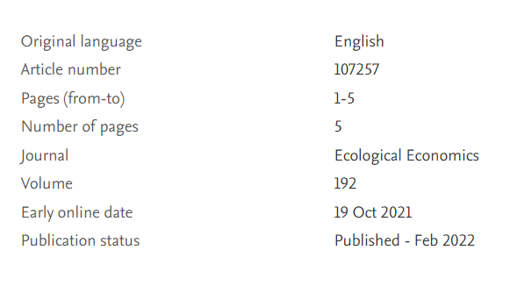
Metadata on different levels
Metadata
(Data providing information about the data)
Everything needed to understand, validate and replicate your research
First level: Metadata on the entire research
- Codebooks - Research logs, logbooks - Protocols
- Description of methodology - Machine settings - Registration in VU Research Portal (PURE)
Second level: Metadata per data asset

Slide 94
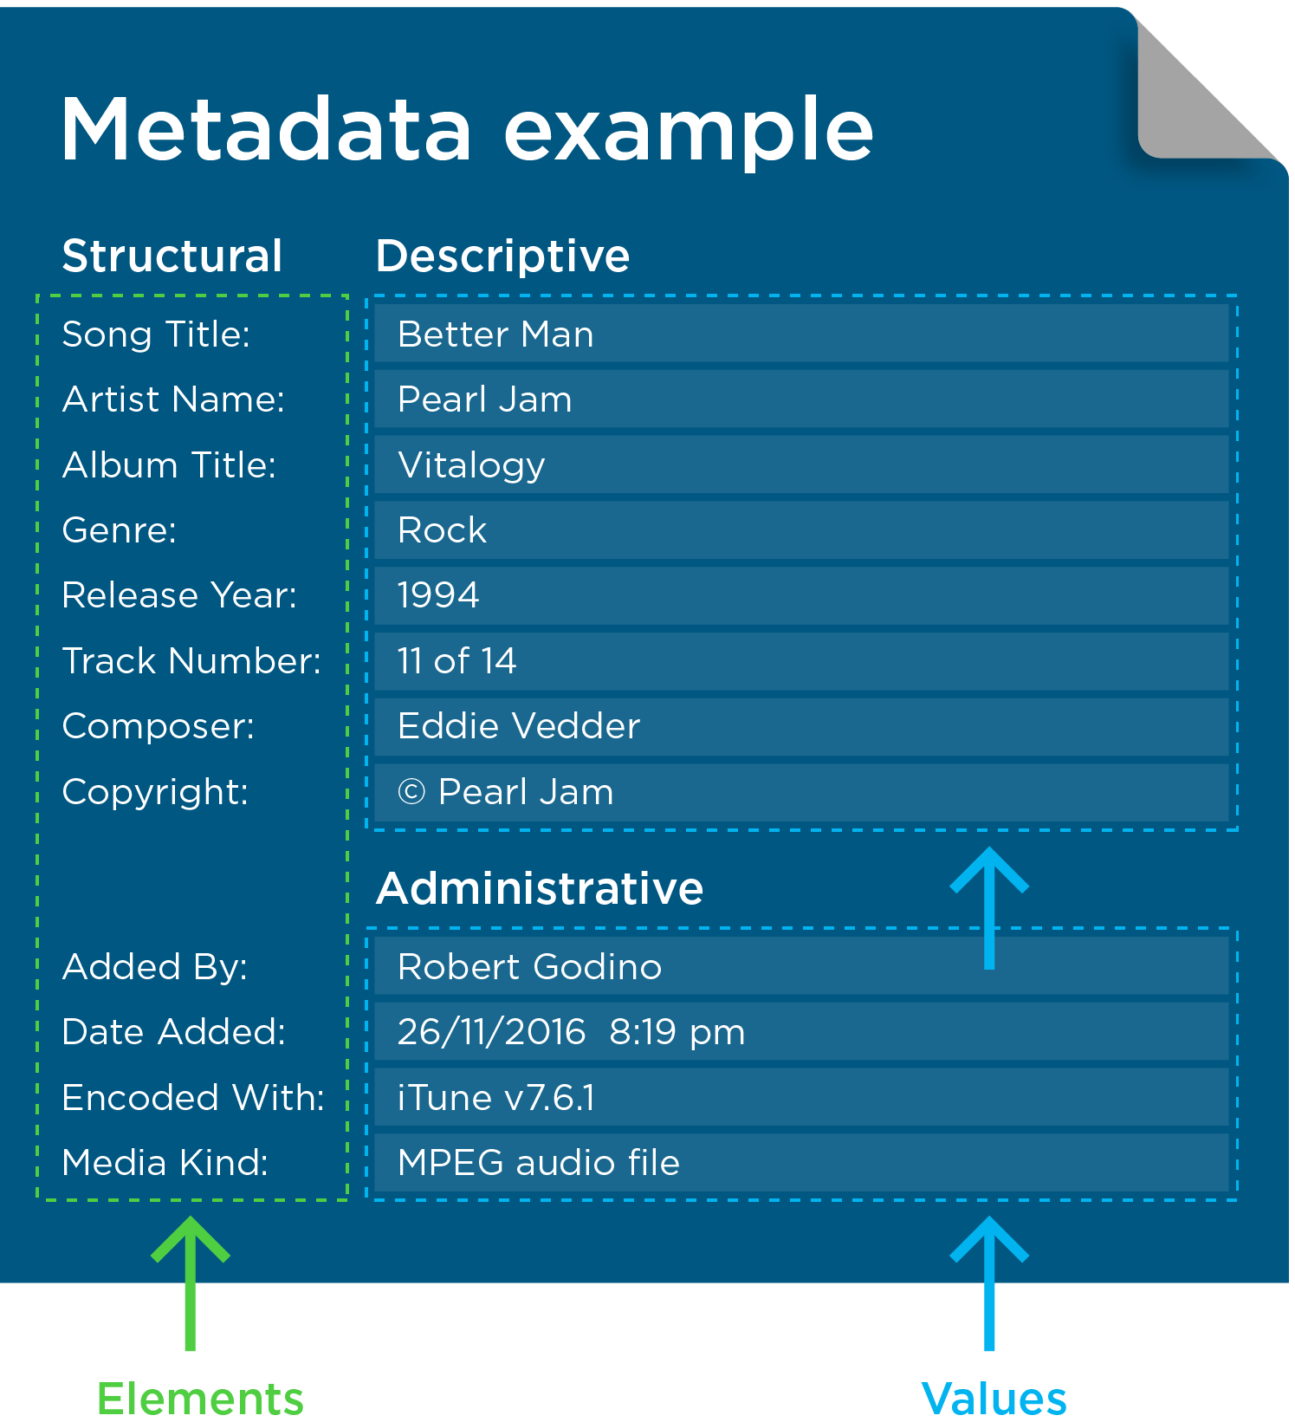
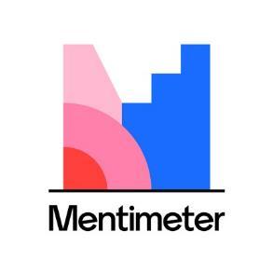
Metadata on data asset level
What kind of metadata would research data need?

Slide 95
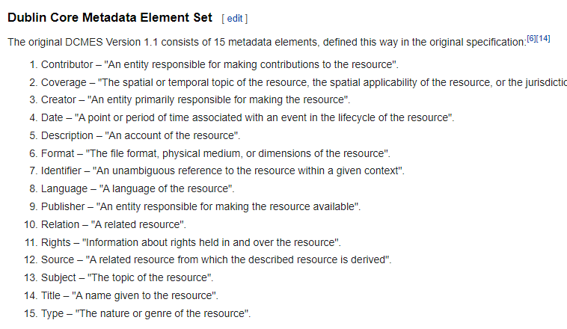

Metadata standard example
Ask your colleagues which kinds metadata standard they prefer!
or
Check out research you admire and how they structured the metadata

Slide 96
Metadata beyond FAIR
Usability for you and your colleagues
Metadata makes sure you are able to use datasets of others for your own research Metadata prevents unfortunate surprises in using datasets “We didn’t know it only ran on a modified Windows 95 in the basement of Harvard”
A bigger impact!
Metadata on research level makes your research findable Metadata on data asset level is publishable data even when everything else is restricted

Slide 97
Data management responsibilities and resources

Slide 98
Rules and regulations
Note: Some projects have data stewards or data managers. They will be in charge of the data in that case
VU Policy – Responsibility of the researcher
2. Researchers are responsible for ensuring that their research data are reliably, traceably and securely stored throughout the data life cycle and that they are able to report the storage location of their data to the department head
Source: VU RDM Policy https://libguides.vu.nl/ld.php?content_id=32045526
During your research you are primarily responsible for your data, but the department head should also know where data from their department resides.
For archived data there should always be someone other than you who can deal with data access requests.
Why? The VU is responsible for the data and since it’s common for researchers to change positions across institutions, you need someone with a more sustainable role (e.g. department head) to have this responsibility.

Slide 99
Costs
Costs – so there won’t be any surprises
You don’t have to be exact – you need to be aware
Examples:
Storage costs
Using third party software
Using student assistants for anonymizing/conducting surveys/etc etc
Developing tools and algoritms
- The privacy champions and data stewards are covered by the VU
Tip: The DMP is a living document. It is okay if you don’t know the costs yet, as long as you anticipate and update the DMP when necessary

Slide 100
Wrap up

Slide 101
Follow up
Submit First draft of Data Management Plan
See Canvas for instructions
Deadline: 29-6-2023
Submit Revised Data Management Plan
Only for PhDs
See Canvas for instructions
Deadline: 14-7-2023
Check out the rubric (see assignments) to see how the DMPs will be evaluated
Issues that are uncertain or unclear at this point: no problem, but be explicit about this and try to write down your thoughts and options so far

Slide 102
Support at ACTA

Slide 103
Support at Beta
Beta RDM website
Data stewards:
Brett Olivier and Christine Dijk rdm.beta@vu.nl
Prospective: RDM contact person for each department
Privacy Champion: Linda Straetemans l.j.straetemans@vu.nl
Research Ethics Review Committee
Website
E: bethcie.beta@vu.nl (Secretary, Christine Dijk)

Slide 104
Support at FGB
FGB RDM website
For privacy and RDM advice: research.data.fgb@vu.nl
Achraf Taimounti, Research Data officer
Rosalie Salameh, Privacy Champion
Scientific and Ethical Review Board (VCWE)
E: vcwe.fgb@vu.nl (Secretary, Anders Schinkel)
Also provide scientific quality review (required for WMO-approval by METC)
Technical support (TO3)
Survey set up, specialized software, app and web development
Equipment for measurements (e.g. optotrak)
Development of new devices
Many materials and labs can be reserved via TopDesk reservation tool (found on webpage in link above)

Slide 105
Support at FRT

Slide 106
Support at FSW
FSW RDM website​
Privacy advice: privacy.fsw@vu.nl​
RDM advice: data steward Koen Leuveld k.leuveld@vu.nl ​
Research Ethics Review Committee (RERC)​
E: rerc.fsw@vu.nl (Secretary, Koen Leuveld)​

Slide 107
Support at RCH

Slide 108
Support at SBE

Slide 109
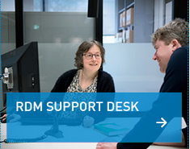
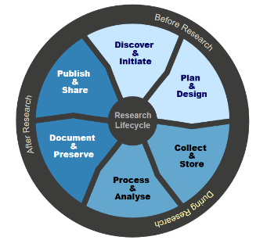
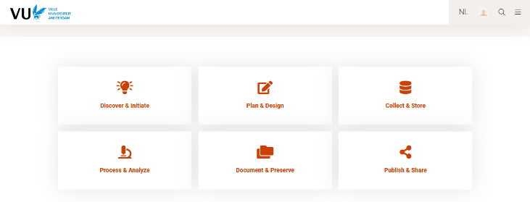
General support
E: rdm@vu.nl
T: +31(0)20 59 85166
LibGuide Research Data Management:
http://libguides.vu.nl/researchdata/
Research Data Support website:
https://vu.nl/en/employee/research-data-support

Slide 110
Support at national and international level
Infrastructures and repositories:
CESSDA (Consortium of European Social Science Data Archives)
ODISSEI (Open Data Infrastructure for Social Science and Econonomic Innovations)
Resources:
Basic steps for pseudonymization
Reference card for anonymization
Practical guidelines for the entire data life cycle: CESSDA Data Management Expert Guide
File formats:
DANS: preferred formats
UK Data Service: recommended formats
Notes:
For version with personal data

Slide 111
Support at national and international level
Resources:
Practical guidelines for the entire data life cycle: CESSDA Data Management Expert Guide
File formats:
DANS: preferred formats
UK Data Service: recommended formats
Notes:
For version without personal data

Slide 112
Training opportunities
June 23, 14.00-16.00 (online): Getting started with OSF
Workshops from the Netherlands eScience Center covering the essentials of version control, online collaboration, reproducible code and good programming practices
June 27, 28, 30 and July 1 (online): Data Carpentry for Social Sciences (update 21-6-2022: waiting list)
July 5-8 (online): Software Carpentries (R)

